Slide 1
Lariat Revenue Analysis
Hayley Baek
Notes:
In this presentation I’m going to go over some of Lariat’s key performance indicators and suggest some strategies to improve its business model and increase revenue.

Slide 2
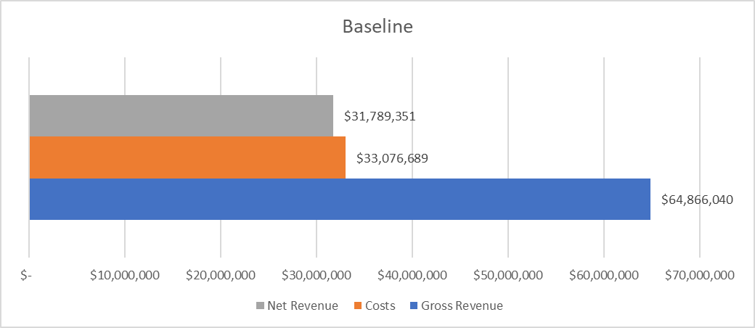
Baseline
What are the observed measures of success?
Gross revenue
Costs
Net revenue
How are these values currently being measured?
How can these metrics be improved?
Notes:
The KPIs that I want to consider in this model are Gross Revenue, Costs, and Profit. As you can see from the chart, gross revenue is a little under $64m and costs are about $33m, meaning profit or net revenue is about $32m. I want to answer with my suggested model the questions of how these are measured, how these values are currently being measured, and illustrate a new model that suggests how these metrics can be improved.

Slide 3
Measured Values
Gross Revenue
Rental’s price per day and rental length
Cost
Each car’s set monthly cost and insurance
Net Revenue
Gross Revenue - Cost
Notes:
I’m going to go over the 3 key performance indicators that I’m considering in this model. Gross revenue, as it is currently calculated, is the multiplication of the rental car’s price per day and rental length. Cost is given from each car’s set monthly cost and insurance, and for each new rental, the cost is calculated per transaction to be adjusted to its rental length. Finally, profit is the difference of gross revenue and cost. As this model exists, there are better ways of calculating these KPIs.

Slide 4
Improving These Metrics
Gross Revenue
Currently no “holiday” surcharge or no “accidents” charge
Cost
More cars with cheaper payments or fewer cars with expensive payments
Net Revenue
Increasing Gross Revenue, decreasing Cost, increasing sales volume
Notes:
What are some ways to improve these metrics? To start with gross revenue, there is currently no holiday surcharge and no accidents charge. This means that rentals during holidays are the same as year-round rentals, despite having the highest sales volume, and drivers that get into accidents are not charged for the accident. Gross revenue can increase with the addition of these additional charges. Cost is measured by car’s monthly cost and insurance. Since these are two fixed values given for each car, cost can be reduced for the company either by having more cars with cheaper payments or fewer cars with more expensive payments. By changing any combination of these two values, the company’s profits will also change. This model is looking to increase gross revenue, decrease cost, and/or increase the sales volume.

Slide 5
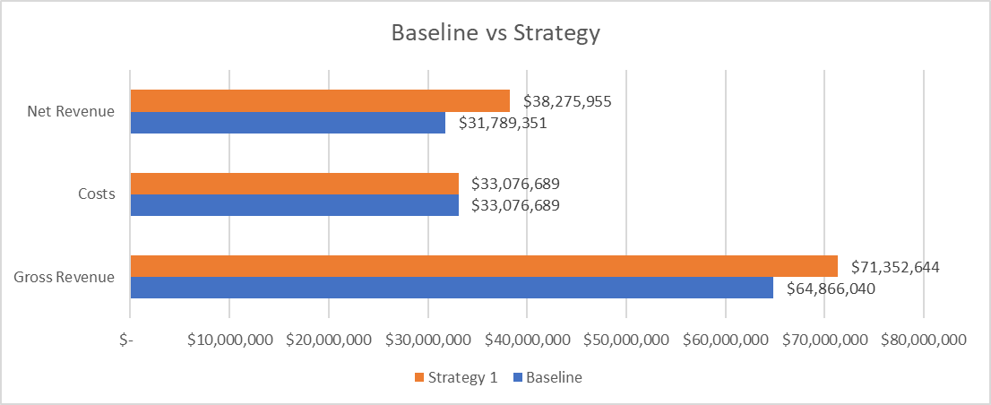
Strategy 1
Assume consistent structure with higher sales volume
Growth rate 10% in Gross Revenue
Results in 20% increase in Net Revenue
Notes:
The first strategy that I will go over assumes a consistent structure with a higher sales volume. This strategy assumes a 10% growth in both gross revenue and cost. The gross revenue grows about $7m with no growth in cost. According to this chart, after growing Gross Revenue by 10% of their base values, profit is shown to have an overall 20% increase from the baseline profit value.

Slide 6
Strategy 2
Add additional charges for holiday rentals and accidents
Holiday surcharge: additional charge 3 days before and after a holiday for $20/day
New Years Day (1/1), Memorial Day (5/28), Independence Day (7/4), Labor Day (9/3), Thanksgiving Day (11/22), Christmas Day (12/25)
Accidents surcharge: additional ‘adjusted cost’ multiplied by ‘rented length’
‘Adjusted cost’ is cost per rental
‘Rented length’ is number of days per rental
Notes:
The second strategy is to add additional charges for holiday rentals and accidents, to increase gross revenue. The holiday surcharge is one where an additional charge 3 days before and after a holiday is added for $20/day. The assumed observed holidays for Lariat are New Years Day, Memorial Day, Independence Day, Thanksgiving Day, and Christmas Day. There is also an accidents surcharge, where a penalty is included which is the transaction’s ‘adjusted cost’ multiplied by the number of rental days which added to the surcharge.

Slide 7
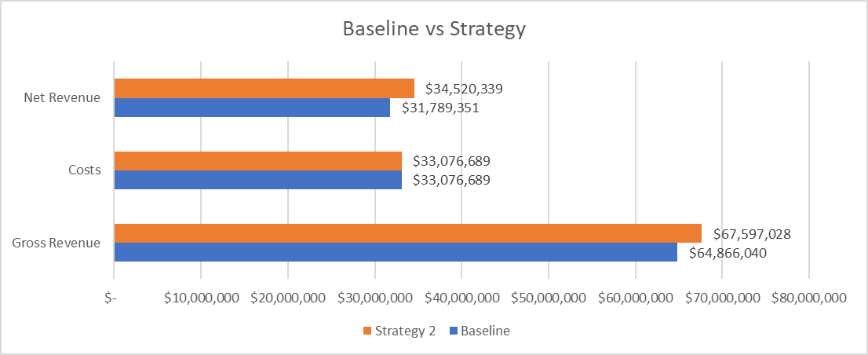
Strategy 2 (cont.)
Add additional charges for holiday rentals and accidents
Results in 4.2% increase in Gross revenue, 8.6% increase in Net Revenue
Notes:
After implementing these additional charges for holiday rentals and accidents, there is a roughly 8% increase in profit, which is about an $3m increase in gross revenue, and therefore in profit.

Slide 8
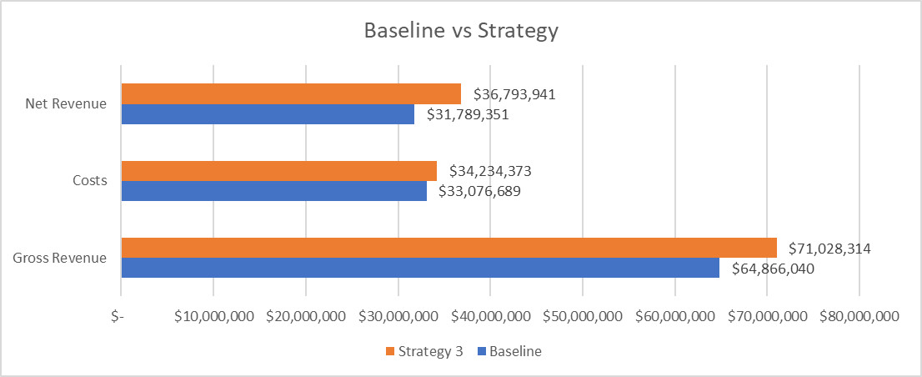
Strategy 3
Redistribute highest costing group of rentals to lowest costing group of rentals using marketing tactics
Results in 9.5% increase in Gross Revenue, 3.5% increase in Cost, 16% increase in Net Revenue
Notes:
The third strategy is to convince customers, through marketing tactics, to rent slightly higher more expensive cars. This strategy assumes that the customers that have rented out the top 400 most expensive costing cars are encouraged to rent out the bottom 400 least expensive costing cars. With this strategy, there is a 9.5% increase in gross revenue, but there is also a 3.5% increase in cost. There is about a $5m increase in gross revenue and about a $1m increase in cost, meaning that the 16% increase in profit equates to about $5m in profit.

Slide 9
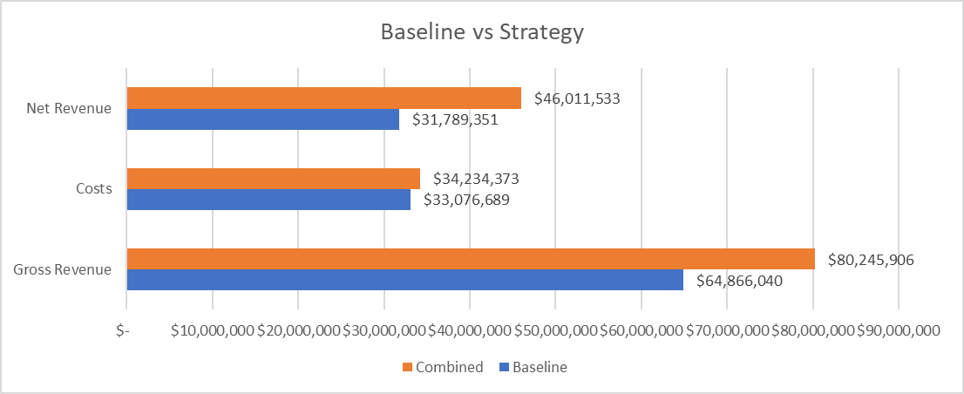
Combined Strategies
Modifying growth, revenue calculations, cost redistribution to optimize structure
Results in 45% increase in Net Revenue
Notes:
The optimized model shows that these 3 strategies be combined of modifying growth, current revenue calculations, and customer redistribution. This combination of growing gross revenue and trying to minimize cost is the model I’m suggesting to increase company revenue. This model will result in an overall 45% increase in profit, which equates to about $14.5m.

Slide 10
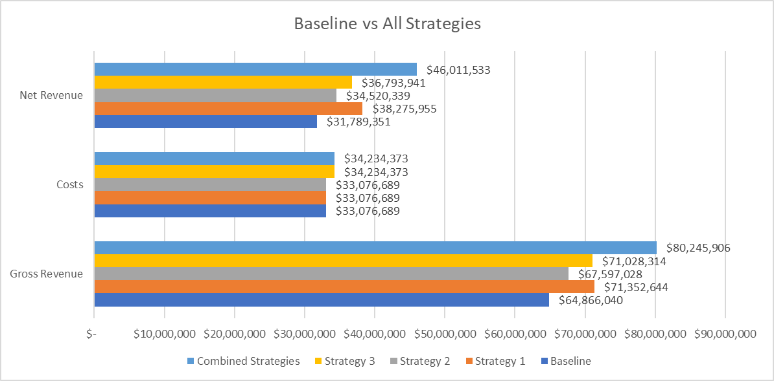
Conclusion
Strategy 1: Assuming ideal growth produces ideal results; uncertain
Strategy 2: Adding surcharge doesn’t produce big results
Strategy 3: Redistributing cheapest options is best individual result
Combined: Combining these strategies produces an optimized model
Notes:
To conclude, I’ve outlined 3 different strategies in which the company can change its business model to increase revenue. Strategy 1 assumes an ideal growth and therefore only reflects ideal results, but it’s uncertain. Strategy 2 which adds a surcharge to increase gross revenue doesn’t produce as big results as the other strategies, but it’s the most cost-effective way of increasing company profits. Strategy 3 of redistributing the cheapest customers to rent more expensive cars is the best individual result for increasing revenue without relying on a growth in sales volume alone. When these strategies are combined, this is my suggested model, optimized to increase Lariat’s overall company profit.

